Slide 1

IoT-Enabled Smart Medicine Reminder System with Real-Time Patient Monitoring
ECA1418
Embedded Systems
Presented by :
Y. Sai Mahathi (192472221)
M. Nandhini (192472318)
G Harika Devi (192412592)
Harsheka Pradeep (192412531)
S.K Jananipriya (192412105)
Supervised by :
Dr. H. Shree Kumar

Slide 2



INTRODUCTION
Medication adherence is essential for maintaining good health.
Many patients, especially elderly individuals, forget to take medicines on time.
Missed medications can lead to serious health complications.
The proposed IoT-based system provides timely medicine reminders through alerts and notifications.
The system records medicine intake status and enables remote monitoring through the Blynk cloud platform.

Slide 3
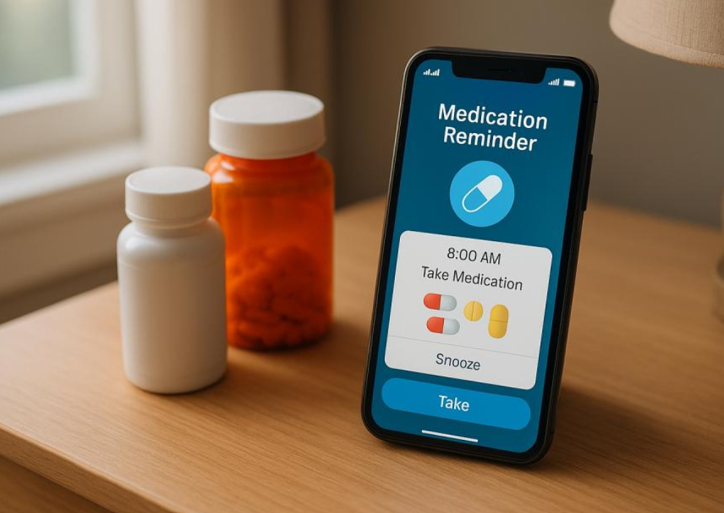
PROBLEM STATEMENT
Existing Problems
Patients often forget medication schedules.
No proper tracking of medicine intake.
Caregivers cannot monitor medication status remotely.
Missed doses can affect patient health.
Proposed Solution
Develop a smart IoT-based medicine reminder system that:
Generates timely reminders.
Tracks medicine intake.
Updates records through cloud technology.
Supports caregivers with remote notifications.

Slide 4
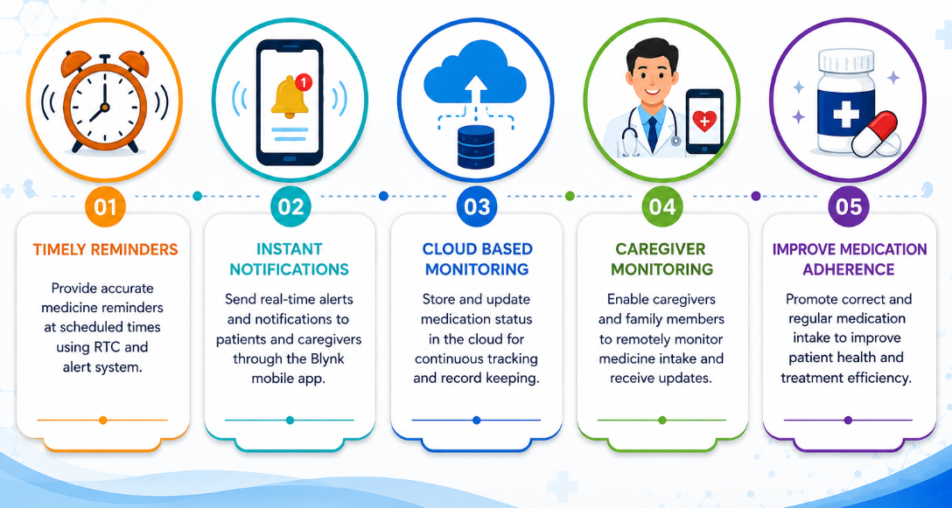
OBJECTIVES

Slide 5
LITERATURE REVIEW
S.No | Title | Year | Key Contribution | Limitation
1 | Intelligent Medication Compliance System Using IoT | 2024 | Developed an IoT-based system to improve medication adherence through timely reminders and monitoring. | Limited cloud-based caregiver support.
2 | IoT-Enabled Medication Reminder System with Alarm Delay Function | 2024 | Provided medicine reminders using alarms and notifications for elderly patients. | No medicine intake confirmation feature.
3 | Smart Pill Box for Home Medication Monitoring | 2025 | Introduced a smart pill box integrated with IoT for tracking medication usage and cloud storage. | Higher implementation cost due to additional hardware.
4 | AI-Based Smart Medical Reminder System | 2025 | Used Artificial Intelligence to generate intelligent medication reminders and improve compliance. | Increased system complexity and cost.
5 | IoT-Based Remote Healthcare Monitoring System | 2025 | Enabled remote patient monitoring and caregiver support using cloud technology. | Focused mainly on monitoring rather than medication confirmation.

Slide 6
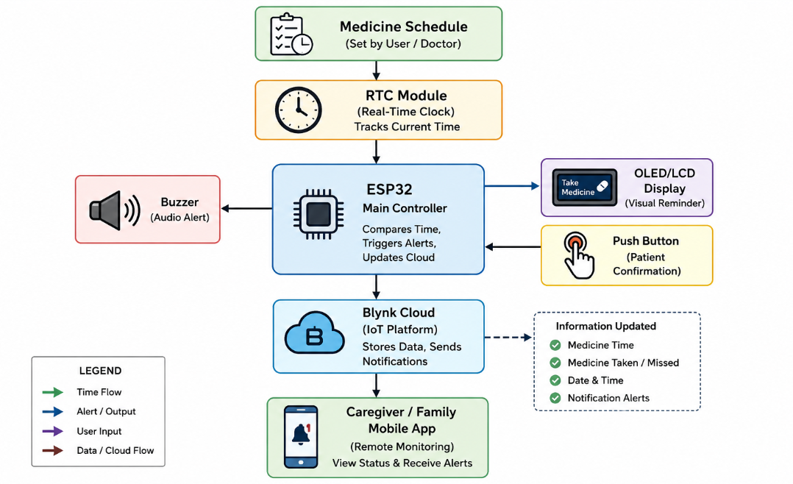
System Architecture

Slide 7
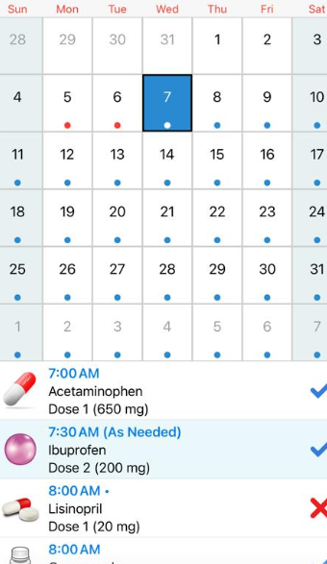
Module 1 : Intelligent Medication
Scheduling Unit
This module manages medicine schedules using the RTC module and ensures accurate timing of medication reminders.
Components
ESP32
RTC Module
Functions
Store medicine schedules
Track current time
Manage medication timing
Synchronize reminder events
Output
Accurate Medication Scheduling

Slide 8
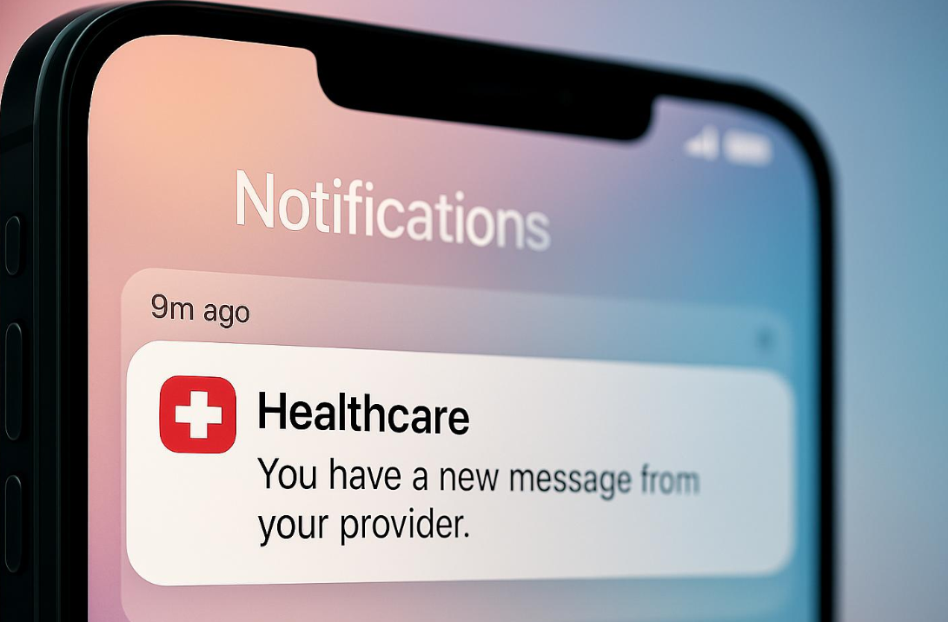
Module 2:Smart Reminder
& Notification Unit
This module generates alerts and notifications when it is time for the patient to take medicine.
Components
ESP32
Buzzer
OLED Display
Blynk App
Functions
Buzzer alerts
Display reminder messages
Mobile notifications
Reminder acknowledgments
Output
Medicine Reminder
Notification Alert

Slide 9
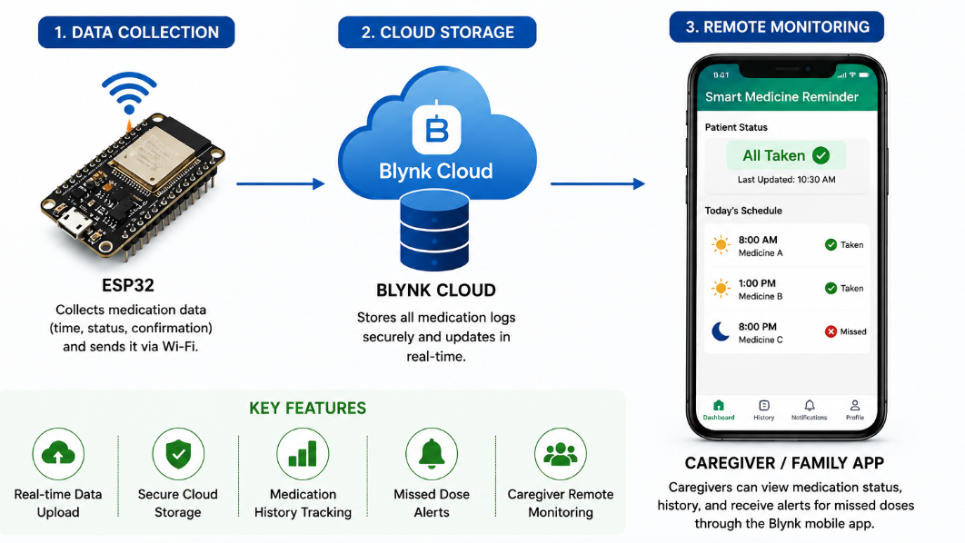
Module 3 : Medication Compliance and Cloud Tracking Unit
This module records whether the patient has taken the medicine and stores the information in the cloud.

Slide 10
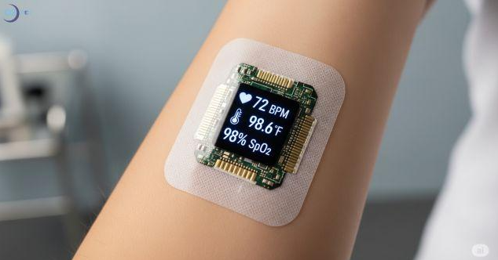
Module 4: Real-Time Patient Health Monitoring Unit
A monitoring unit that continuously measures the patient’s vital health parameters using sensors and provides real-time health information.
Functions
Measures heart rate, SpO₂, and body temperature.
Processes sensor readings.
Continuously monitors patient health.
Identifies abnormal readings based on predefined limits.
Output
Real-time health readings such as Heart Rate: 78 BPM, SpO₂: 98%, Temperature: 36.8°C.

Slide 11
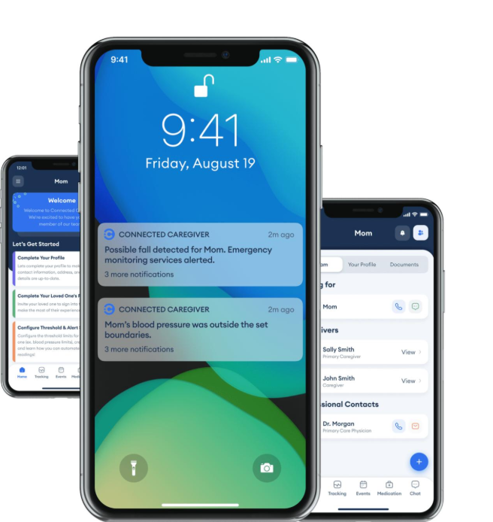
Module 5: Emergency Alert & Caregiver Notification Unit
An alert unit that analyzes medication and health status and notifies the caregiver when a missed dose or abnormal health condition is detected.
Functions
Detects missed medication and abnormal vital signs.
Generates emergency alerts.
Sends notifications to caregivers through IoT/mobile interface.
Displays patient status for remote monitoring.
Output
Alert/notification such as “Medicine Missed” or “Abnormal SpO₂ Detected”, along with the patient’s current status.

Slide 12
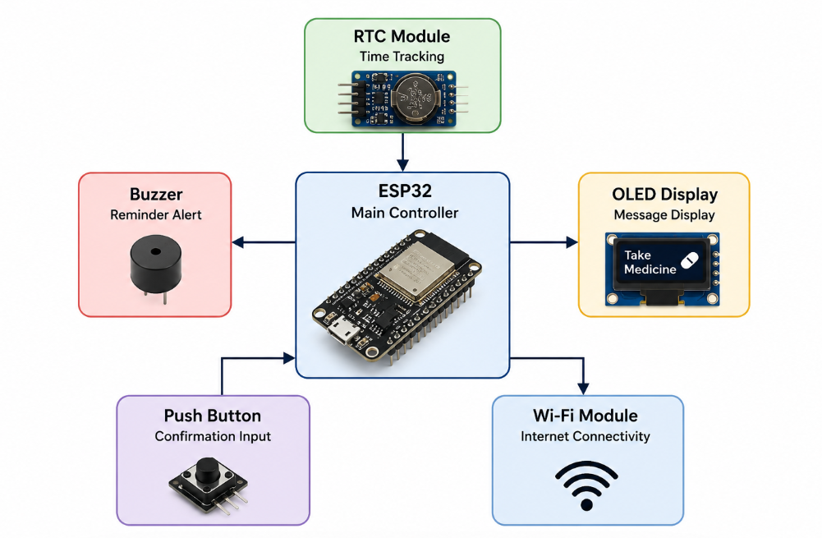
Hardware Components

Slide 13
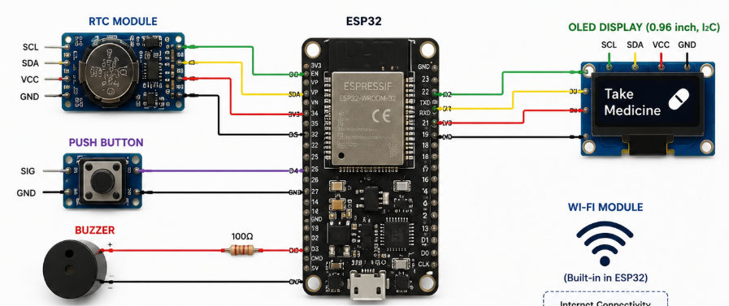

CIRCUIT DIAGRAM

Slide 14
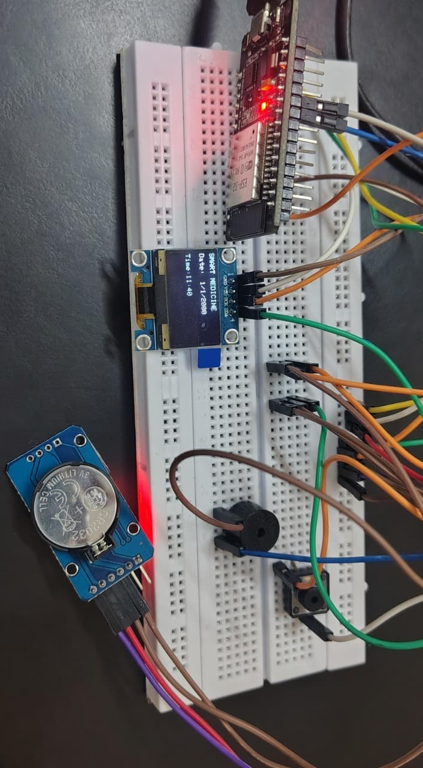
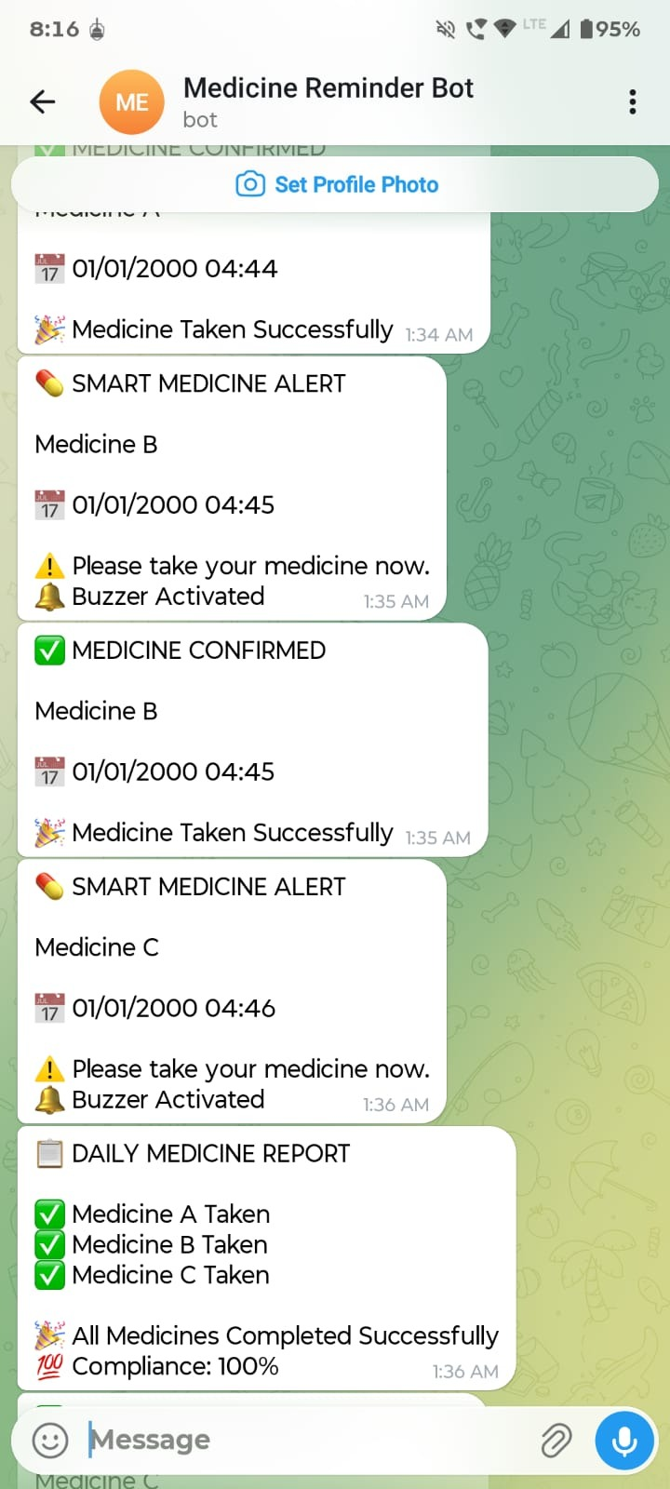
Project Demonstration & Results

Slide 15

Advantages & Applications
Advantages
Timely medication reminders
Easy to use
Low cost
Cloud connectivity
Remote caregiver support
Reduces missed medication
Improves patient safety
Suitable for elderly patients
Applications
Hospitals
Home Healthcare
Elderly Care
Chronic Disease Patients
Medication Management Systems
IoT Healthcare Solutions

Slide 16
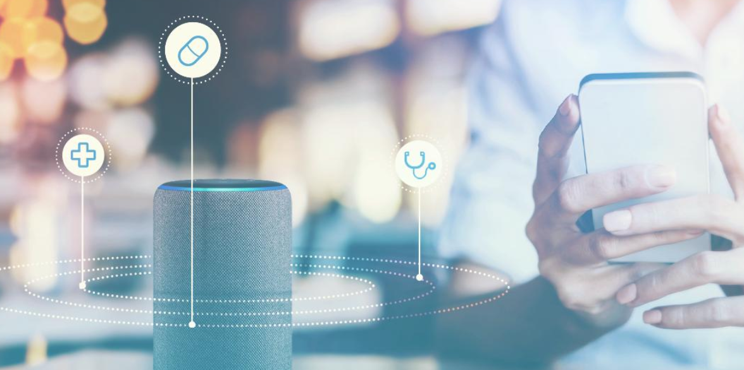
Future Enhancements
Voice-Based Medicine Reminders Add voice alerts in multiple languages for better accessibility.
Smart Pill Box Integration Automatically detect whether the medicine compartment has been opened.
SMS and WhatsApp Notifications Send reminder and missed-dose alerts through SMS or WhatsApp.
Health Sensor Integration Integrate heart rate, temperature for complete patient monitoring.
AI-Based Medication Management Use Artificial Intelligence to provide personalized medicine schedules and adherence analysis.

Slide 17
CONCLUSION
The IoT-Enabled Smart Medicine Reminder System provides an efficient solution for medication management by combining automated reminders, cloud-based tracking, and caregiver support. The system improves medication adherence, reduces missed doses, and enhances patient care through IoT technology.

Slide 18
References
[1] H. D. Vu et al., “Smart Pill Box: An IoT-Integrated Application for Monitoring Patient Medication Usage at Home,” Proceedings of the 2024 9th International Conference on Cloud Computing and Internet of Things (CCIOT 2024), 2025. DOI: 10.1145/3704304.3704308.
[2] R. Mardhiyyah, “IoT-Enabled Medication Reminder System with Alarm Delay Function,” Fidelity Jurnal Teknik Elektro, vol. 6, no. 3, pp. 1–6, Sept. 2024. DOI: 10.52005/fidelity.v6i3.234.
[3] “Intelligent Medication Compliance System for Patients Using IoT,” IEEE International Conference on Intelligent Computing and Communication Technologies (ICICT 2024), IEEE, 2024. DOI: 10.1109/ICICT62343.2024.00075.
[4] Sasipriya S. et al., “Enhancing Medication Adherence in Smart Medical Reminder Systems Using the AI-MA Algorithm,” International Journal of Engineering Research & Technology (IJERT), vol. 13, no. 5, 2025.
[5] “A Multi-Sensor IoT Platform for Monitoring Medicine Storage Beyond the Hospital,” Internet of Things Journal, 2025.

Slide 19


